Slide 1
Building foot print extraction

Slide 2
Problem Statement: Identify the building footprints on the satellite image
Input
Satellite image
Dataset
Training Dataset
The training set contains 10000 images
Image tiles covering a surface of 250 m × 250 m each (at a 30 cm resolution).
Labelling:
Semantic labelling of aerial images
Building Footprint Mask
Testing Dataset
Instead of splitting adjacent portions of the same images into the training and test subsets, different cities are included in each of the subsets
Satellite Image – Size in multiples of 32, image must be square, i.e. width and height of the image must be equal. So that we can avoid the missing's
Model
Existing Building Footprint Segmentation
Deep Learning Framework : Pytorch
ReFineNet neural network – Weights trained on forementioned dataset
To Improve the model accuracy and to be work on the 50cm we need to go for the MASKRCNN with the 50cm training dataset (min 5000 images)
Output
Masked Image with identified building footprints, which can be further extracted as polygons

Slide 3
Workflow
Satellite Image
(32x X 32x pixels)
Check for tif files, convert to jpegs
Identify Building Footprint
Post process
Regularise the foot prints using special algorithms
Convert image coordinates to georeferenced coordinates
Deep Learning
(RefineNet)
Opencv for image analysis
Input
Analysis
Postprocess and Output

Slide 4
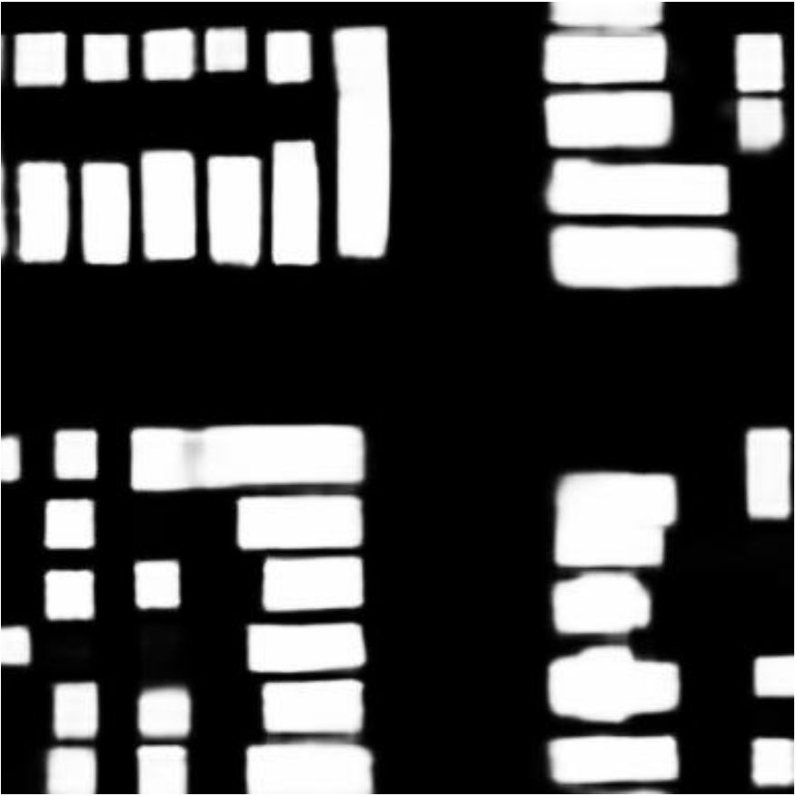
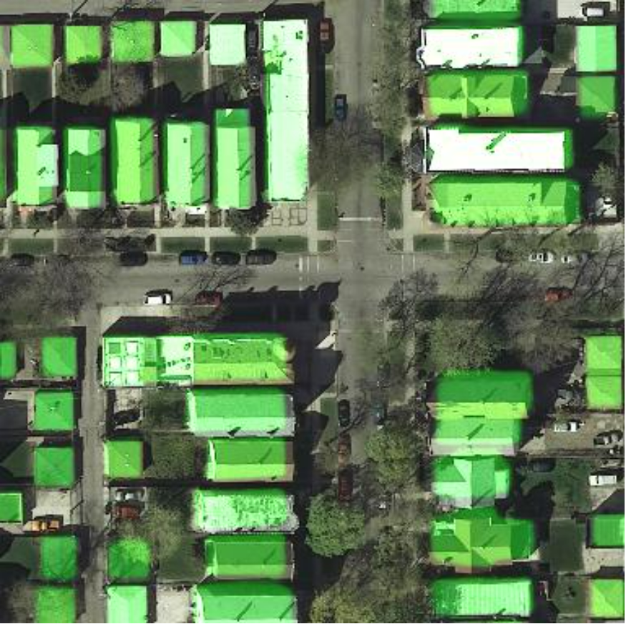

Slide 5
